Slide 1



EaTEzy

Slide 2
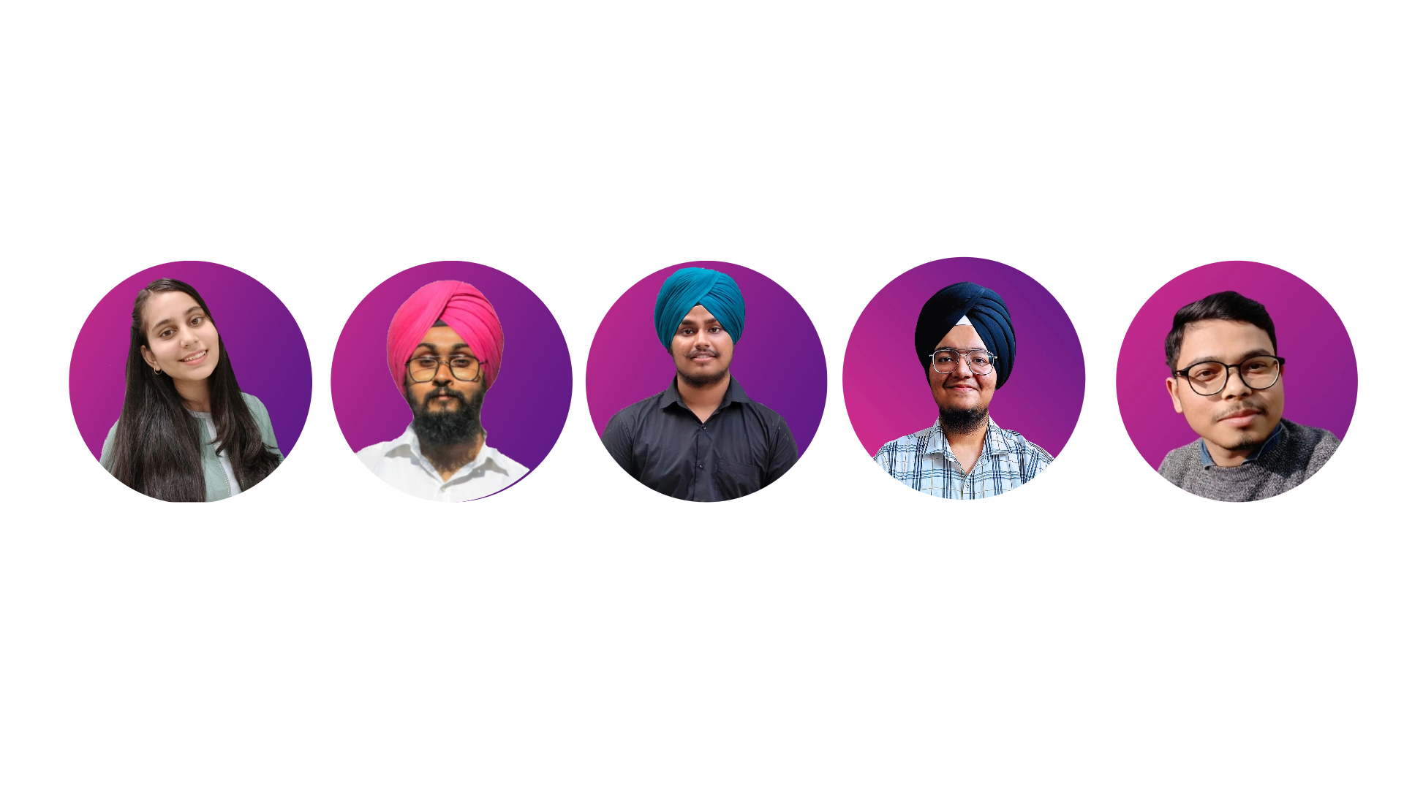
Meet Our Team
Eshaa Bhasin
Arshdeep Singh
Prableen Singh
Harjot Singh
Ansh Rajput

Slide 3

The Problem
Are you also tired of standing in long queues outside your college canteen. Struggling for the peaceful lunch you deserve after some exhilarating classes. Even though after getting your lunch you get late for classes.
Say no more !!
The Solution
With our intuitive website either you are a canteen owner or a college student being a student you don’t have to stand in long queues and wait for your food being prepared and being the canteen owner you don’t have to deal with some angry teenagers who on top are hungry also

Slide 4
User Walk Through
Student
The Students needs to login using there respective student ID’s .
So that they can be verified that they belong to respective college .
After being verified they get access to their colleges canteen’s menu online at our platform where they can order whatever they want.

Slide 5
User Walk Through
Canteen Owners
The canteen owners are needed to sign in as admin and put their respective credentials.
Then they are asked to further include their menus.
Now they are good to go and student’s of their respective colleges can order without even hassling in long lines.

Slide 6
Features
Real-Time Order Updates
Intuitive Admin Dashboard
Data Science Integration
Experience the convenience of real-time updates on your orders. Our platform ensures you're always in the loop, providing instant notifications from the moment you place your order to the minute it's ready for pickup.
Empowering canteen owners, our intuitive admin dashboard offers a comprehensive view of your operations. Monitor orders, track inventory, and analyze customer preferences seamlessly. Effortlessly manage your business with user-friendly interfaces designed for efficiency.
Elevate your canteen management to the next level with cutting-edge data science implementation. Leverage advanced analytics to gain valuable insights into customer behavior, order patterns, and popular menu items. Make informed decisions, optimize stock levels and enhance customer service

Slide 7
Features
Data Analytics
User-Friendly Interface
Feedback Mechanism
We'll carefully collect and study user data, including food likes and ordering habits. This will give us helpful information to share with canteen partners. They can then improve their menus and services based on this data, making your dining experience better.
Designed with simplicity in mind, our user-friendly interface ensures a seamless experience for both students and canteen owners. Effortlessly browse menus, place orders, and manage inventory with just a few clicks.
Foster communication and continuous improvement. We value your feedback. Our platform includes a feedback mechanism where students can share their experiences, enabling canteen owners to refine their services .

Slide 8
Tech Stack
Svelte
PocketBase
Tailwind CSS
Numpy
Matplotlib

Slide 9
Platform Fee
Whoever uses our platform and does the payment through it we will charge a 5% platfrom fee.
Special Coupons
Offer exclusive coupons and discounts to subscribing students, providing them with cost-effective dining options
Business
Model

Slide 10
Analytics Dashboard
Provide administrators with access to a comprehensive analytics dashboard. It allows them to monitor data on user preferences and ordering habits, helping them make data-driven decisions and assist canteen partners in enhancing their services.
Business
Model
Custom Insights
Offer customizable data reports, giving administrators the flexibility to focus on specific aspects of user behavior and preferences.

Slide 11
FUTURE PLANS
Advanced Personalization: Invest in advanced algorithms and AI-driven recommendations to provide highly personalized menu suggestions, promotions, and user experiences.
Partnerships with Food Delivery Services: Collaborate with established food delivery companies to expand your delivery reach and offer users a wider variety of food options.
Community Building: Foster a sense of community among users by organizing virtual food-related events, contests, and social forums

Slide 12
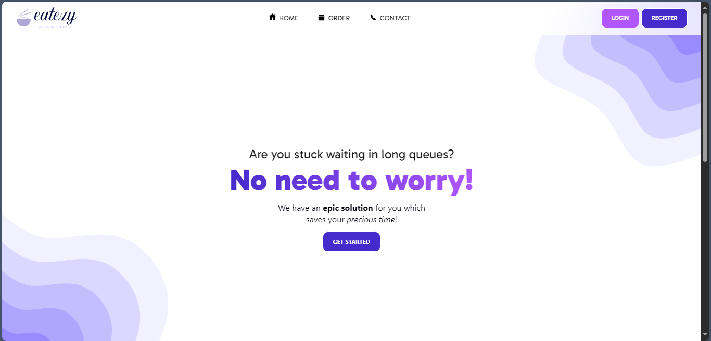
Prototype

Slide 13
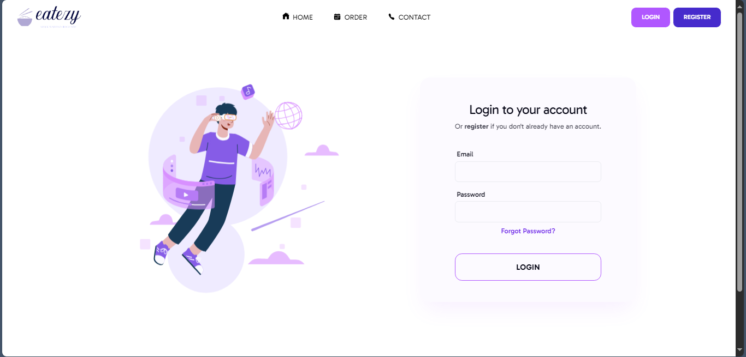
Prototype

Slide 14
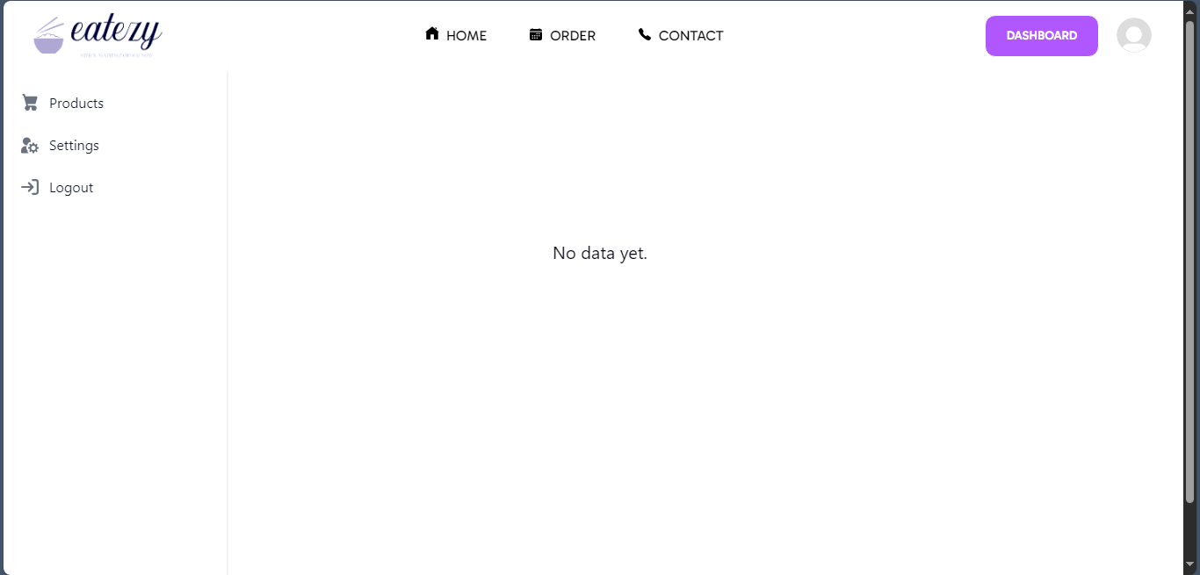
Prototype

Slide 15
Thank You!

